Slide 1
Name of the project
Author, Date

Slide 2
Services on-failure

Slide 3
Service in Linux
[Unit] This is generally used for defining metadata for the unit and configuring the relationship of the unit to other units.
[Install] section. This section is optional and is used to define the behaviour or a unit if it is enabled or disabled.
[Service] section is used to provide configuration that is only applicable for services
Some Command in Linux service:
systemctl daemon-reload
systemctl restart ‘myAppRecovery.service’
systemctl status ‘myAppRecovery.service’

Slide 4
project motivation
- database services are alive (mongoDB) - backend service is alive (gunicone) - frontend service is alive (httpd) - sampler service is alive (labiT), prevent not updated data.

Slide 5
CREATE SERVICE IN LINUX
RRestart=on-failure when the service fail it inserted into
OnFailuer=send emailwhen the service fail it inserted into
OnFailuer=send email
[Unit]
Description=ROT13 demo service
After=network.target
OnFailure=myAppRecovery.service
[Service]
Restart=on-failure
RestartSec=1
User=root
ExecStart=/root/server.py
[Install]
WantedBy=multi-user.target

Slide 6
Create service in Linux
[Unit]
Description= service to send email
After=network.target
[Service]
User=root
ExecStart=/usr/bin/python /.autodirect/mthswgwork/hhassan/git/e2e_ver/workplaceHala/service_mail_alert.py
Restart=no
[Install]
WantedBy=multi-user.target

Slide 7
create an email that will send a notification by the time service fail:
·Create an email (labmon@nvidia.com) using OOP, python to send email.
·find a way to execute service alert fail.
·create email data
·Send email

Slide 8
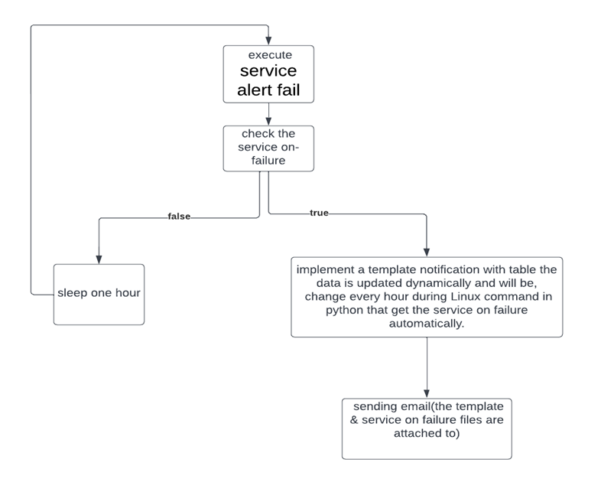
flow diagram

Slide 9
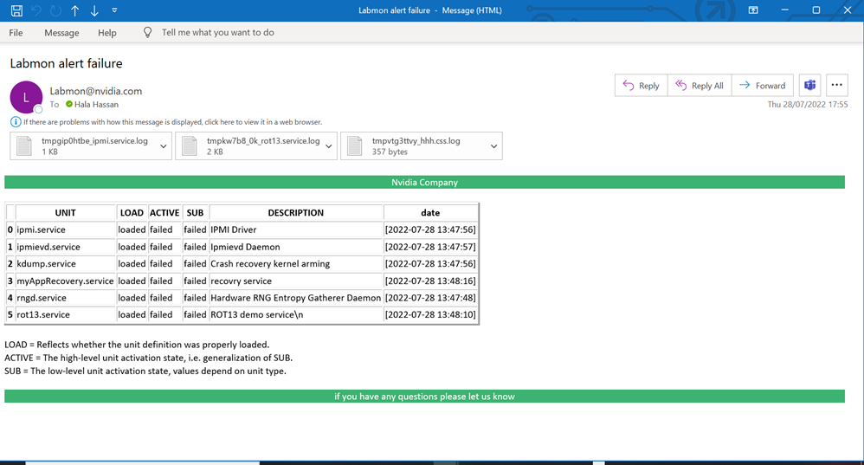
Demo of project

Slide 10
next step

Slide 11
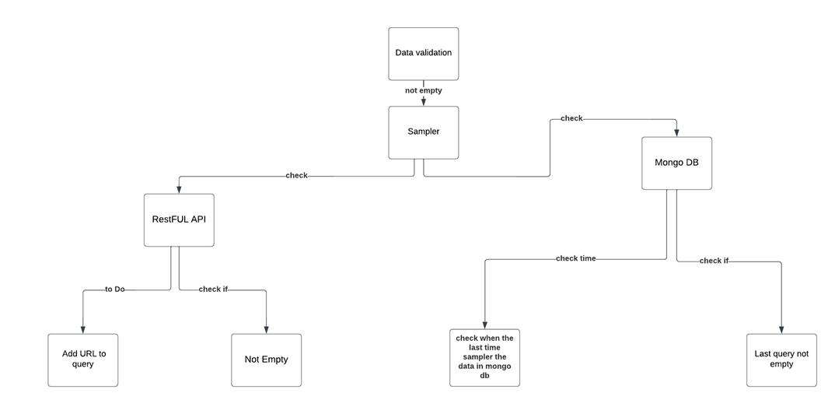
Check Data validation:

Slide 12
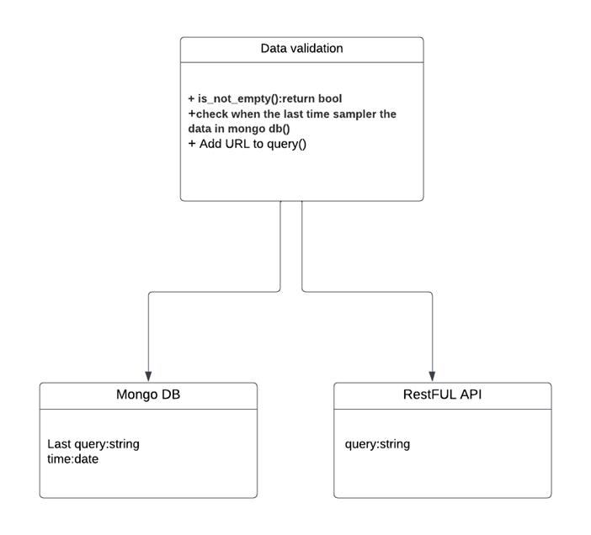
Data validation flow diagram

